Slide 1

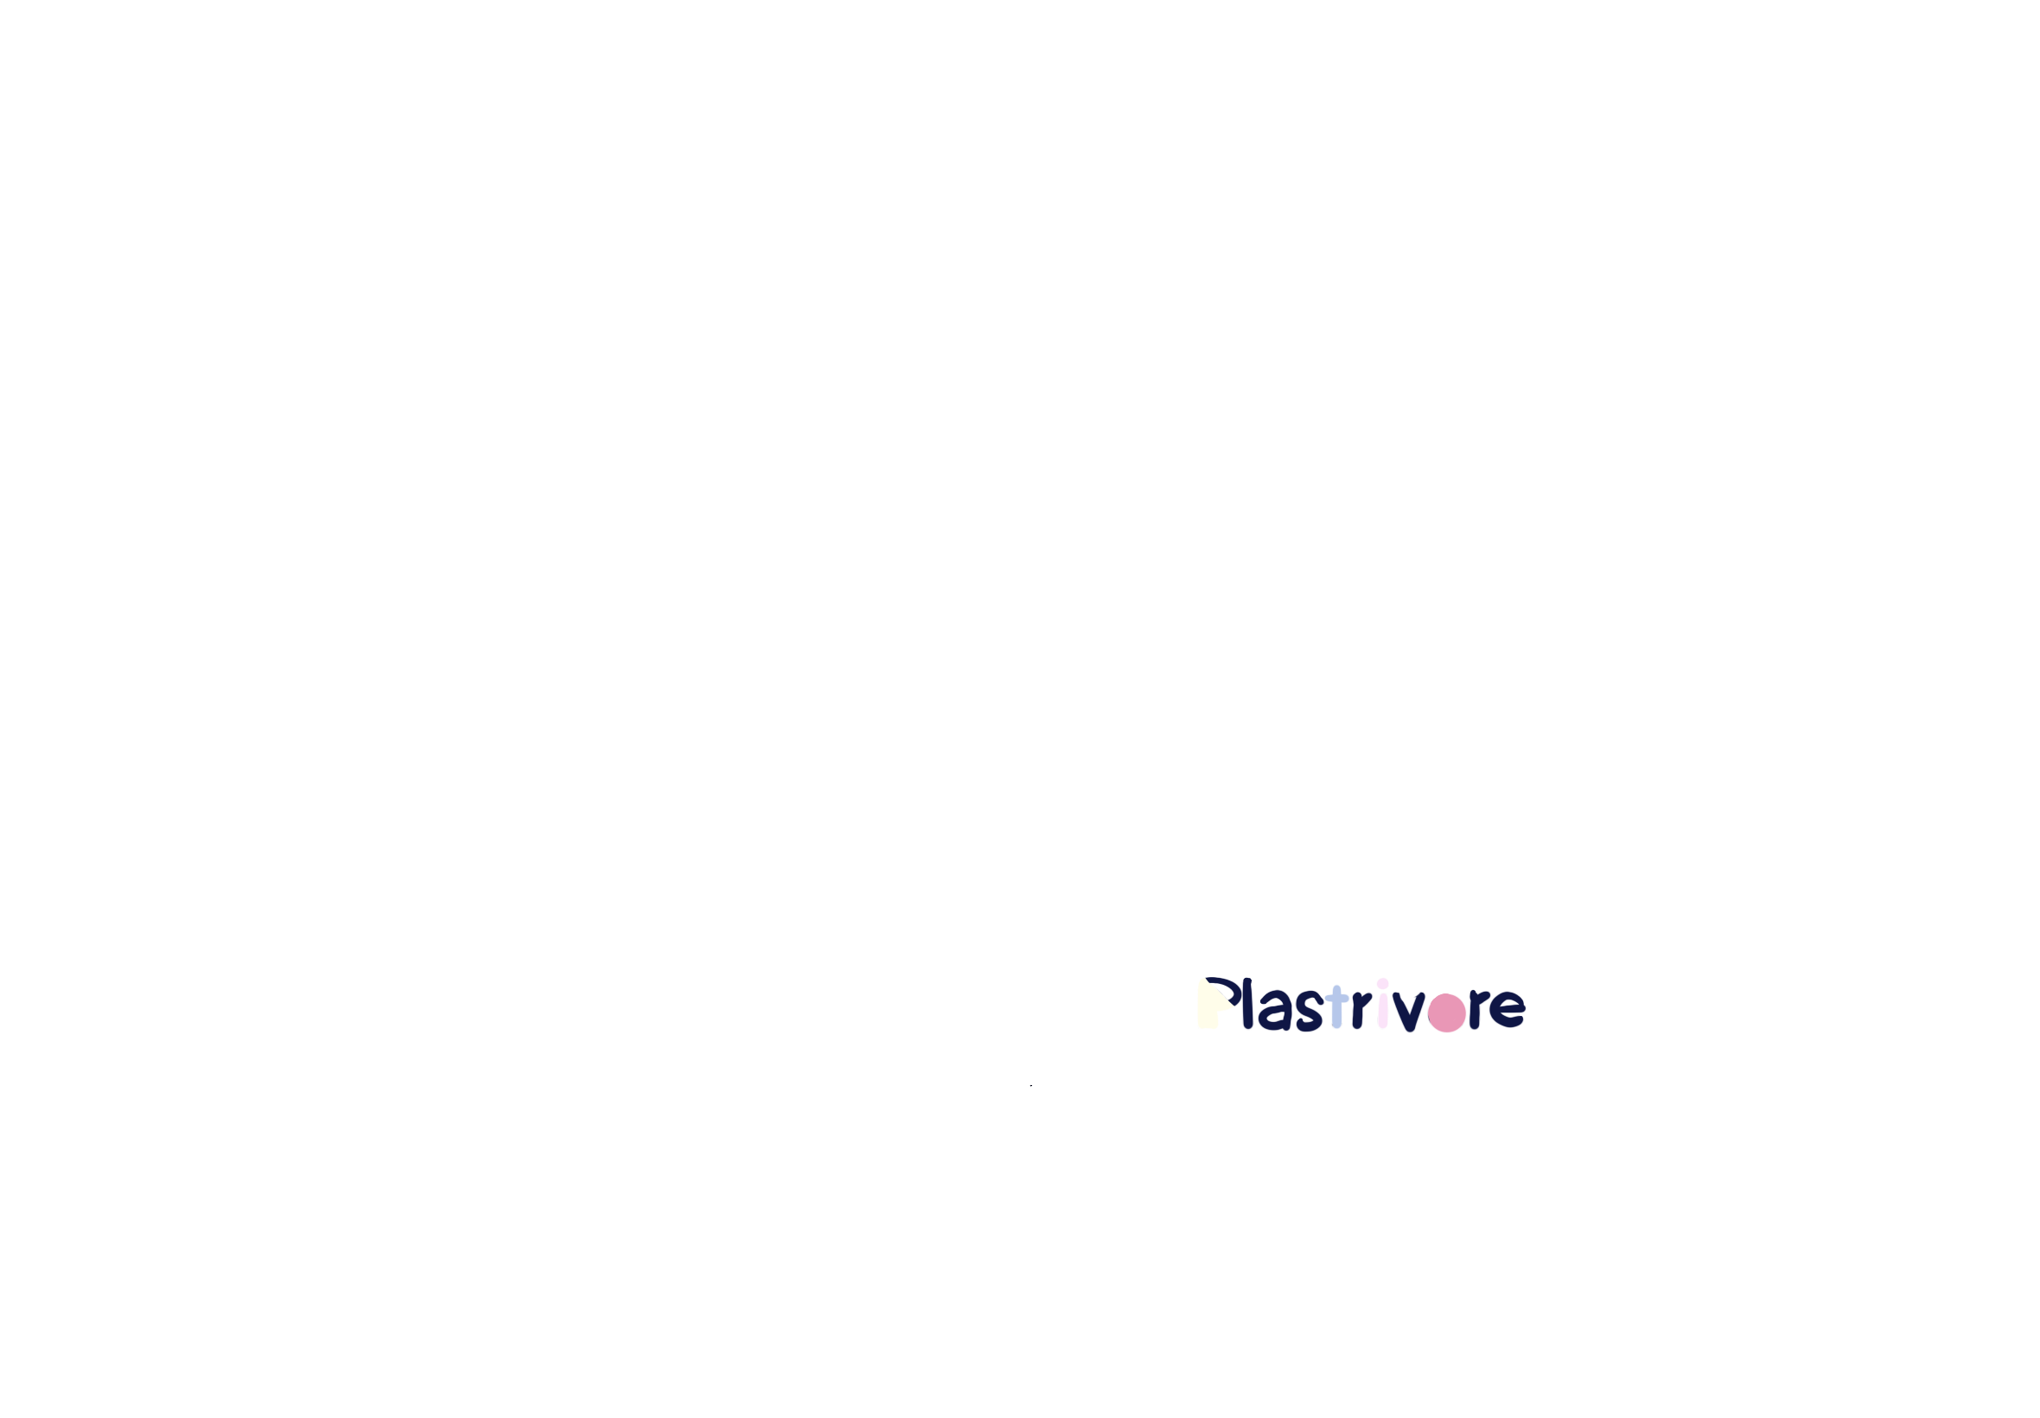
EnteroPlastivore
HOME
PROJECT
SAFETY
HUMAN PRACTICE
MODEL
TEAM
Let’s start the journey!

Slide 2


*见小红书
值得参考！动画交互细节拉满的创意网站 这是一家位于... http://xhslink.com/o/3SGhRUM3FnC
复制后打开【小红书】查看笔记！类似效果，上面大色块掉下来等等
Fortunately, we modified the chassis bacteria and named it

Slide 3
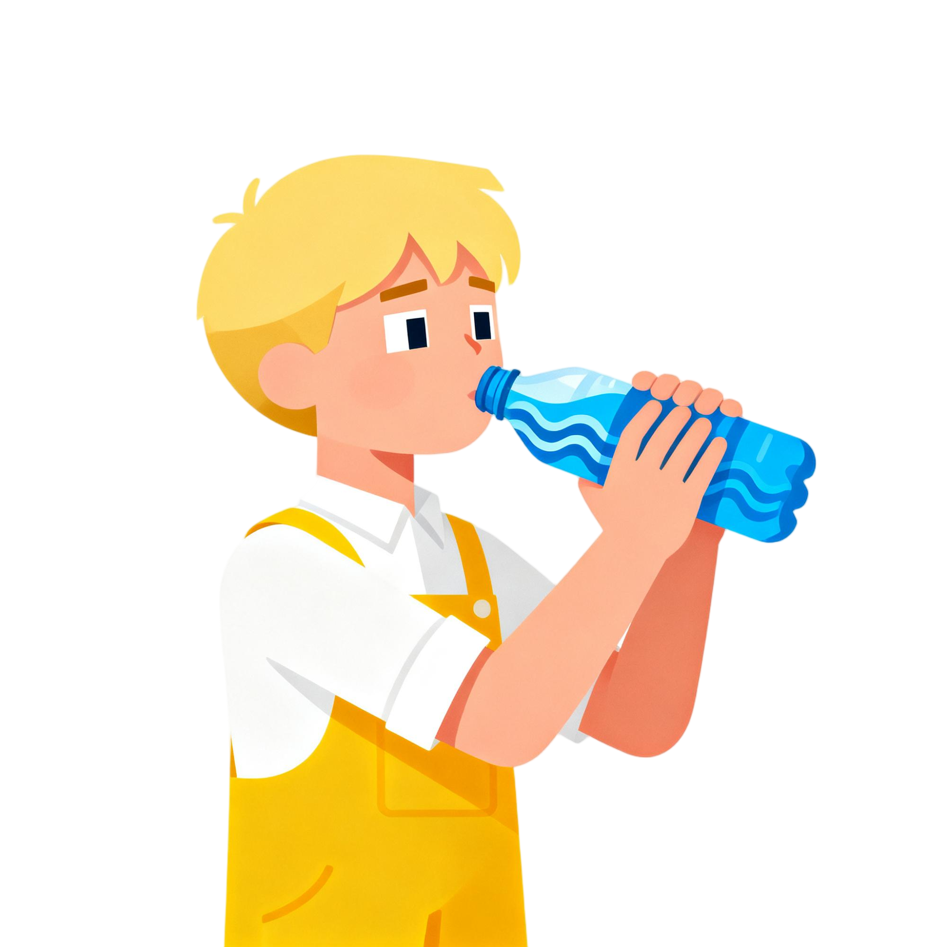



The invention of plastic has brought us great convenience.
Nowadays, it is everywhere.
Every bite. Every drink...
plastic bag
take-out box
water bottle

Slide 4
plastic bag
take-out box
water bottle
Over the past few decades, plastic has been constantly breaking down into “microplastics”, which are ingested by living organisms.

Slide 6




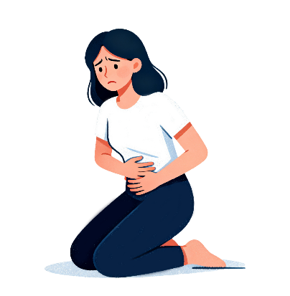
There are 325
microplastic particles in every liter of bottled water we drink.

Slide 7
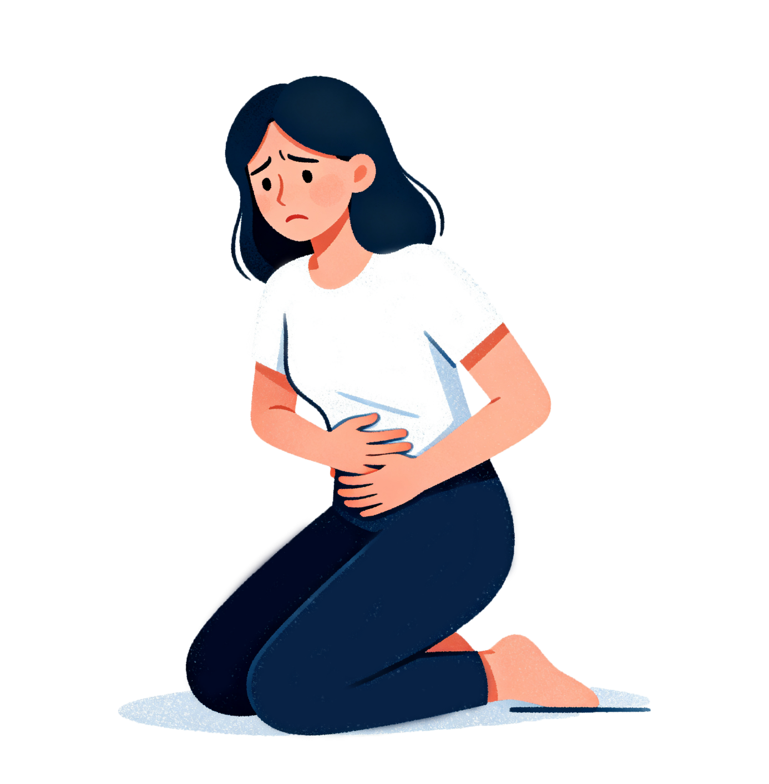
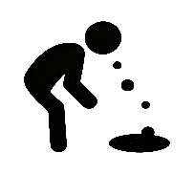

*如果可以的话 想要在这里加上一个 字体从左到右浮现的效果
It is shown that plastic pollution has caused about
million people to experience gastrointestinal symptoms such as bloating & diarrhea.
BLOATING
230
DIARRHEA

Slide 8
EnteroPlastivore
HOME
PROJECT
SAFETY
HUMAN PRACTICE
MODEL
TEAM
Fortunately, we modified the chassis bacteria and named it
"EnteroPlastivore"

Slide 9
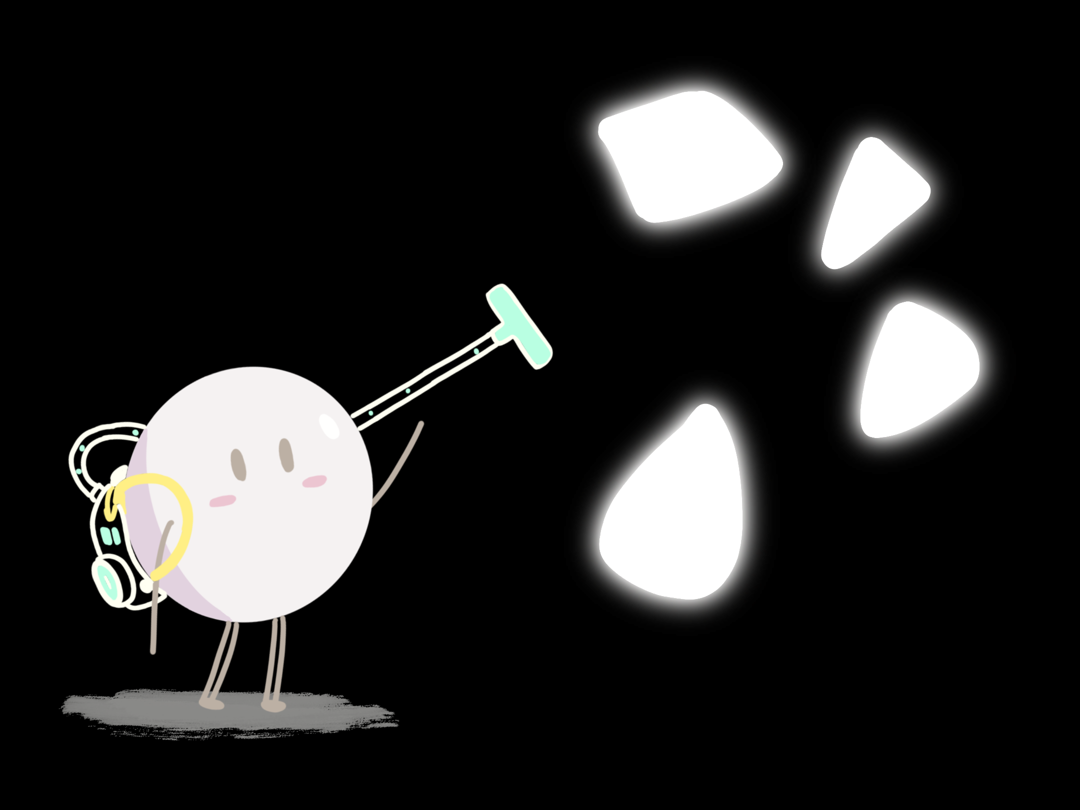
EnteroPlastivore
HOME
PROJECT
SAFETY
HUMAN PRACTICE
MODEL
TEAM
Fortunately, we modified the chassis bacteria and named it
"EnteroPlastivore"

Slide 10
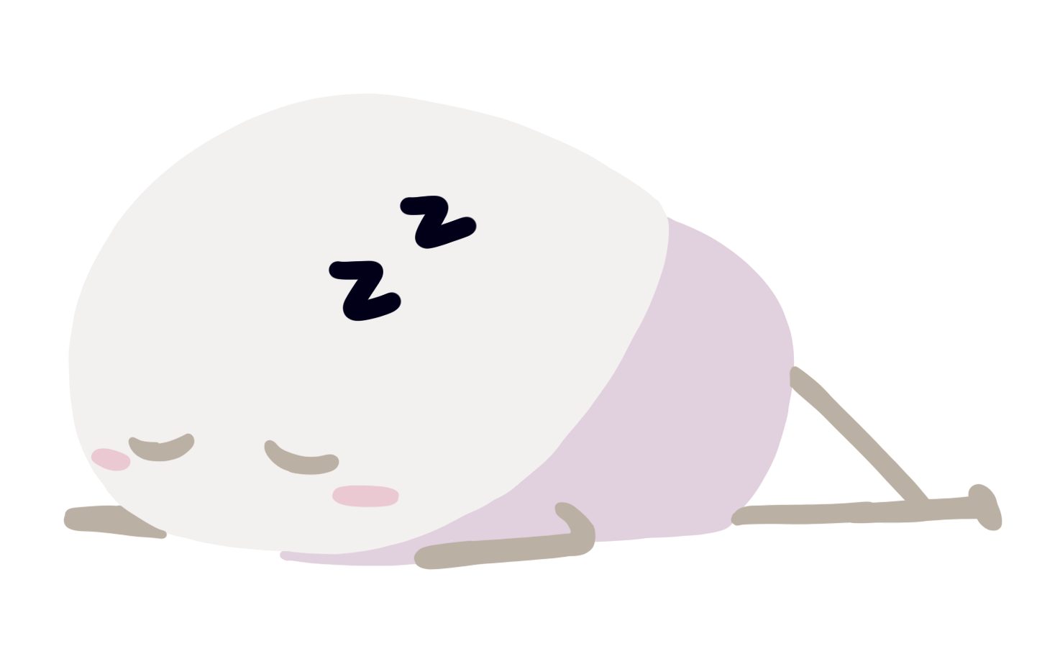

EnteroPlastivore
HOME
PROJECT
SAFETY
HUMAN PRACTICE
MODEL
TEAM
It will be encapsulated in a capsule to facilitate its entry into the body.
*这个胶囊也是想做个悬浮的效果
小人是想着左右悬浮的

Slide 11
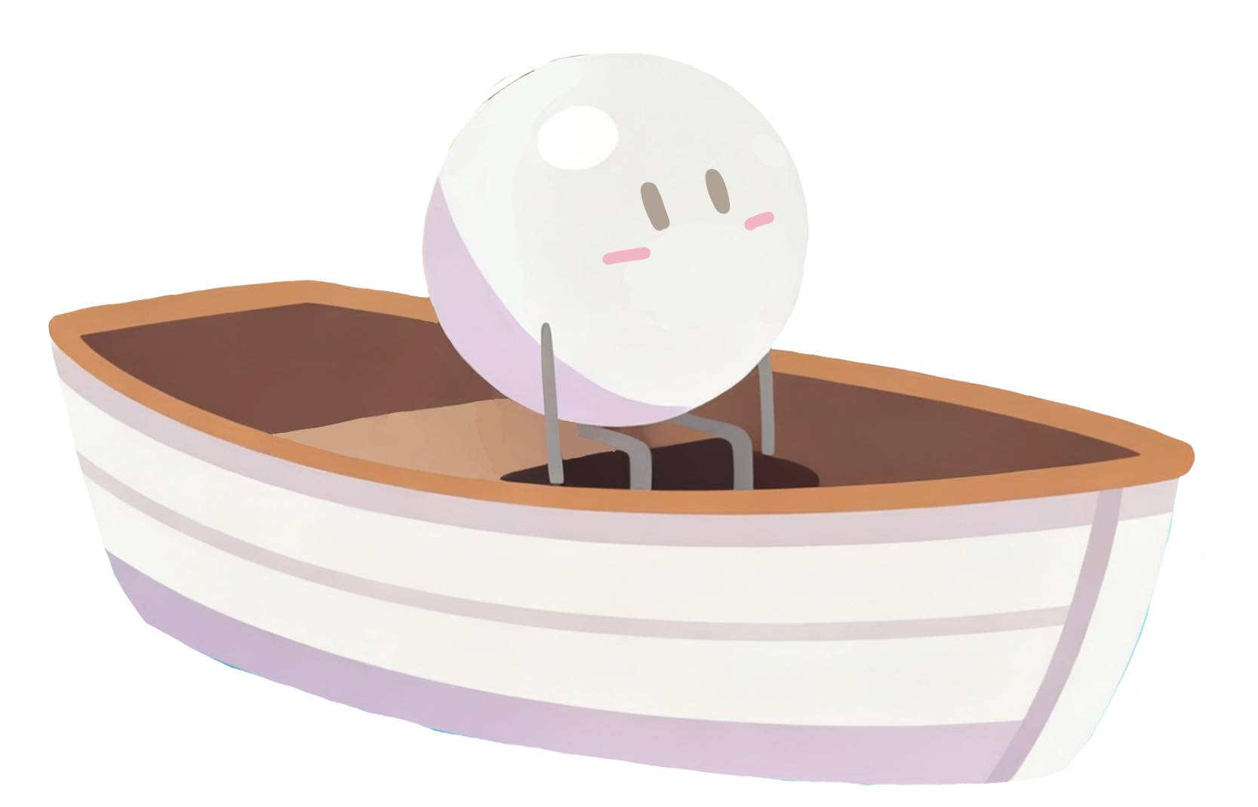
Once you swallow the capsule,
we will navigate through the tumultuous waves of the digestive system,
and an exciting adventure will begin!

Slide 12
*这里用的平滑 本身是想做海浪汹涌的效果
Once you swallow the capsule,
we will navigate through the tumultuous waves of the digestive system,
and an exciting adventure will begin!

Slide 13

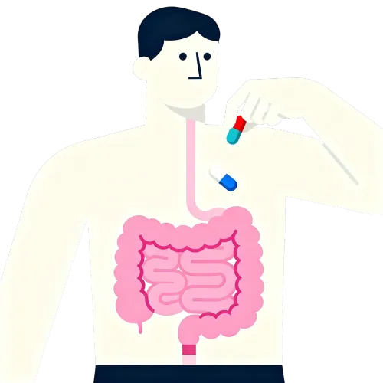
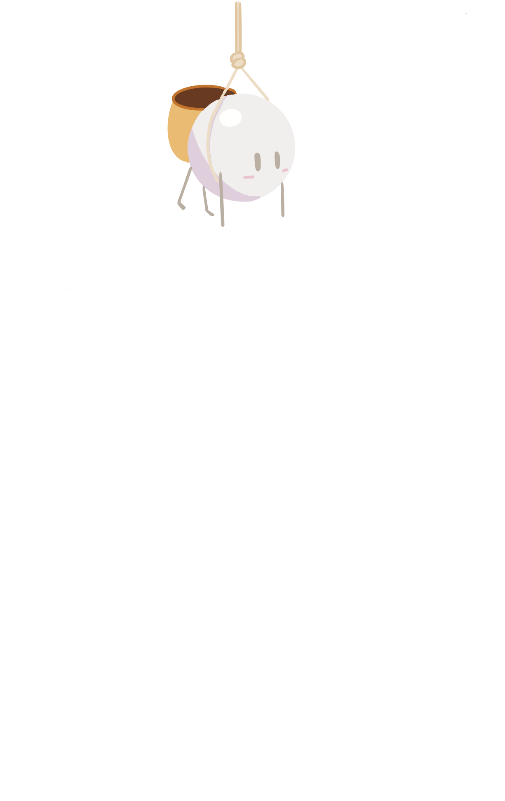

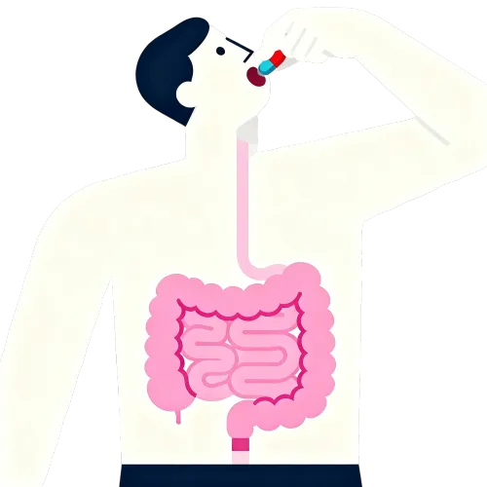
QQ弹弹的效果参考这个
好看的界面动效设计 10142024 Demo视频来自 ALEX BEND... http://xhslink.com/o/6ExNbia6uUo
复制后打开【小红书】查看笔记！
Fortunately, we modified the chassis bacteria and named it
"EnteroPlastivore"
In your gut, we take the lead, seeking out
*光标往下滑的时候，首先弹出两个人和肠道，
左下角两个圆添加一些QQ弹弹的动态效果，然后光标往下滑的时候两个小人分别掉下来，手碰到发光微塑料，微塑料变成光点，进入背篓中，同时弹出下面几句台词，可以再适当添加一些动态效果，比如说光标摸一下他们，会发生什么变化。
breaking down those lurking microplastics,
turning them into
something they're not

Slide 14
QQ弹弹的效果参考这个
好看的界面动效设计 10142024 Demo视频来自 ALEX BEND... http://xhslink.com/o/6ExNbia6uUo
复制后打开【小红书】查看笔记！
Fortunately, we modified the chassis bacteria and named it
"EnteroPlastivore"
In your gut, we take the lead, seeking out
*光标往下滑的时候，首先弹出两个人和肠道，
左下角两个圆添加一些QQ弹弹的动态效果，然后光标往下滑的时候两个小人分别掉下来，手碰到发光微塑料，微塑料变成光点，进入背篓中，同时弹出下面几句台词，可以再适当添加一些动态效果，比如说光标摸一下他们，会发生什么变化。
breaking down those lurking microplastics,
turning them into
something they're not

Slide 15
QQ弹弹的效果参考这个
好看的界面动效设计 10142024 Demo视频来自 ALEX BEND... http://xhslink.com/o/6ExNbia6uUo
复制后打开【小红书】查看笔记！
Fortunately, we modified the chassis bacteria and named it
"EnteroPlastivore"
In your gut, we take the lead, seeking out
*光标往下滑的时候，首先弹出两个人和肠道，
左下角两个圆添加一些QQ弹弹的动态效果，然后光标往下滑的时候两个小人分别掉下来，手碰到发光微塑料，微塑料变成光点，进入背篓中，同时弹出下面几句台词，可以再适当添加一些动态效果，比如说光标摸一下他们，会发生什么变化。
breaking down those lurking microplastics,
turning them into
something they're not

Slide 16



Fortunately, we modified the chassis bacteria and named it
*从前一个页面变成这个页面的切换，为一个往下滑鼠标，画面往前走的效果，具体小红书上有该效果。
to ensure that our clean-up efforts do not disturb our host's peace of mind.
"EnteroPlastivore"

Slide 17
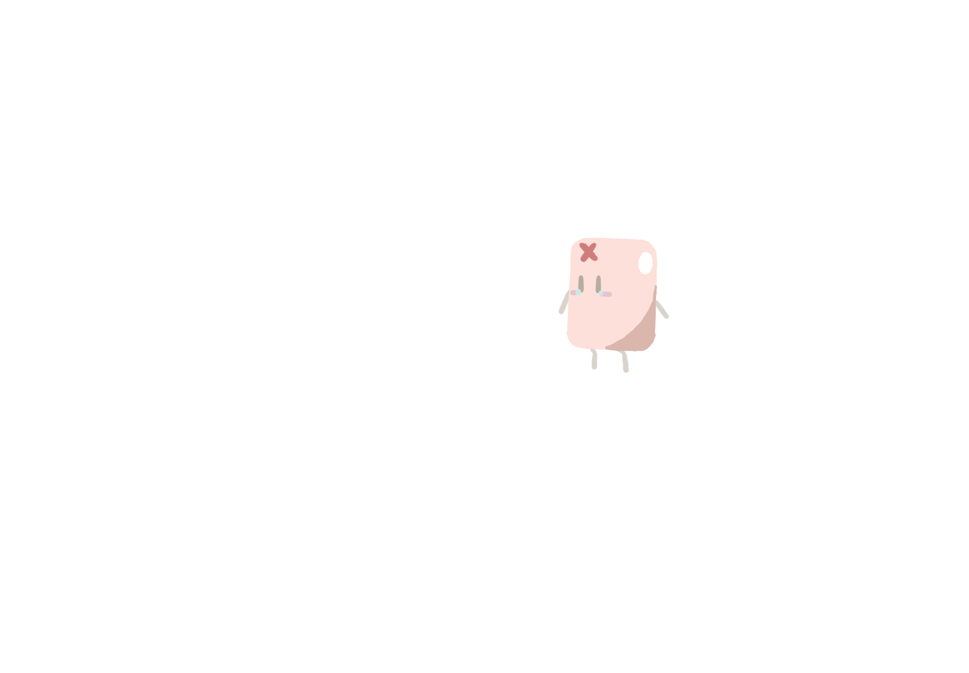
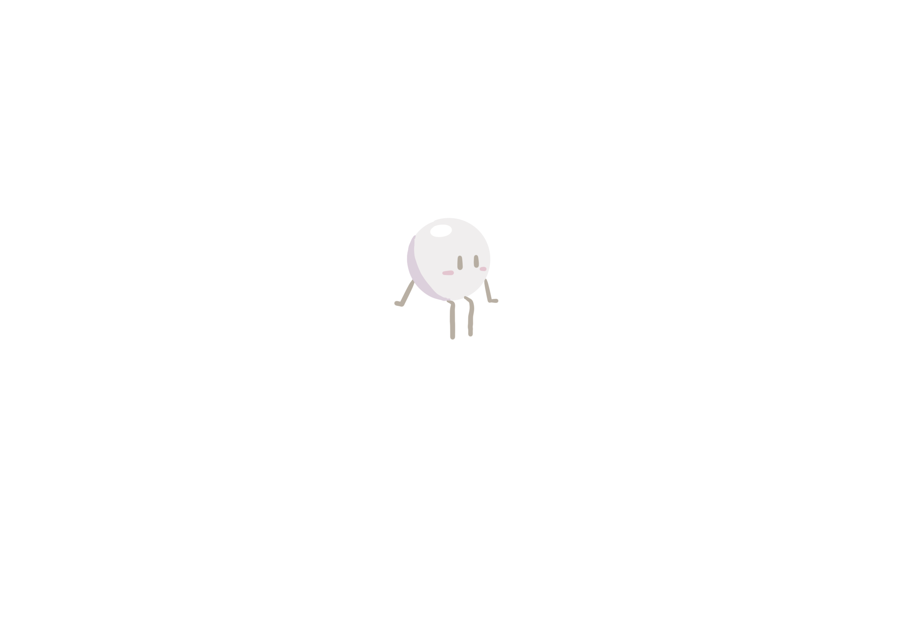
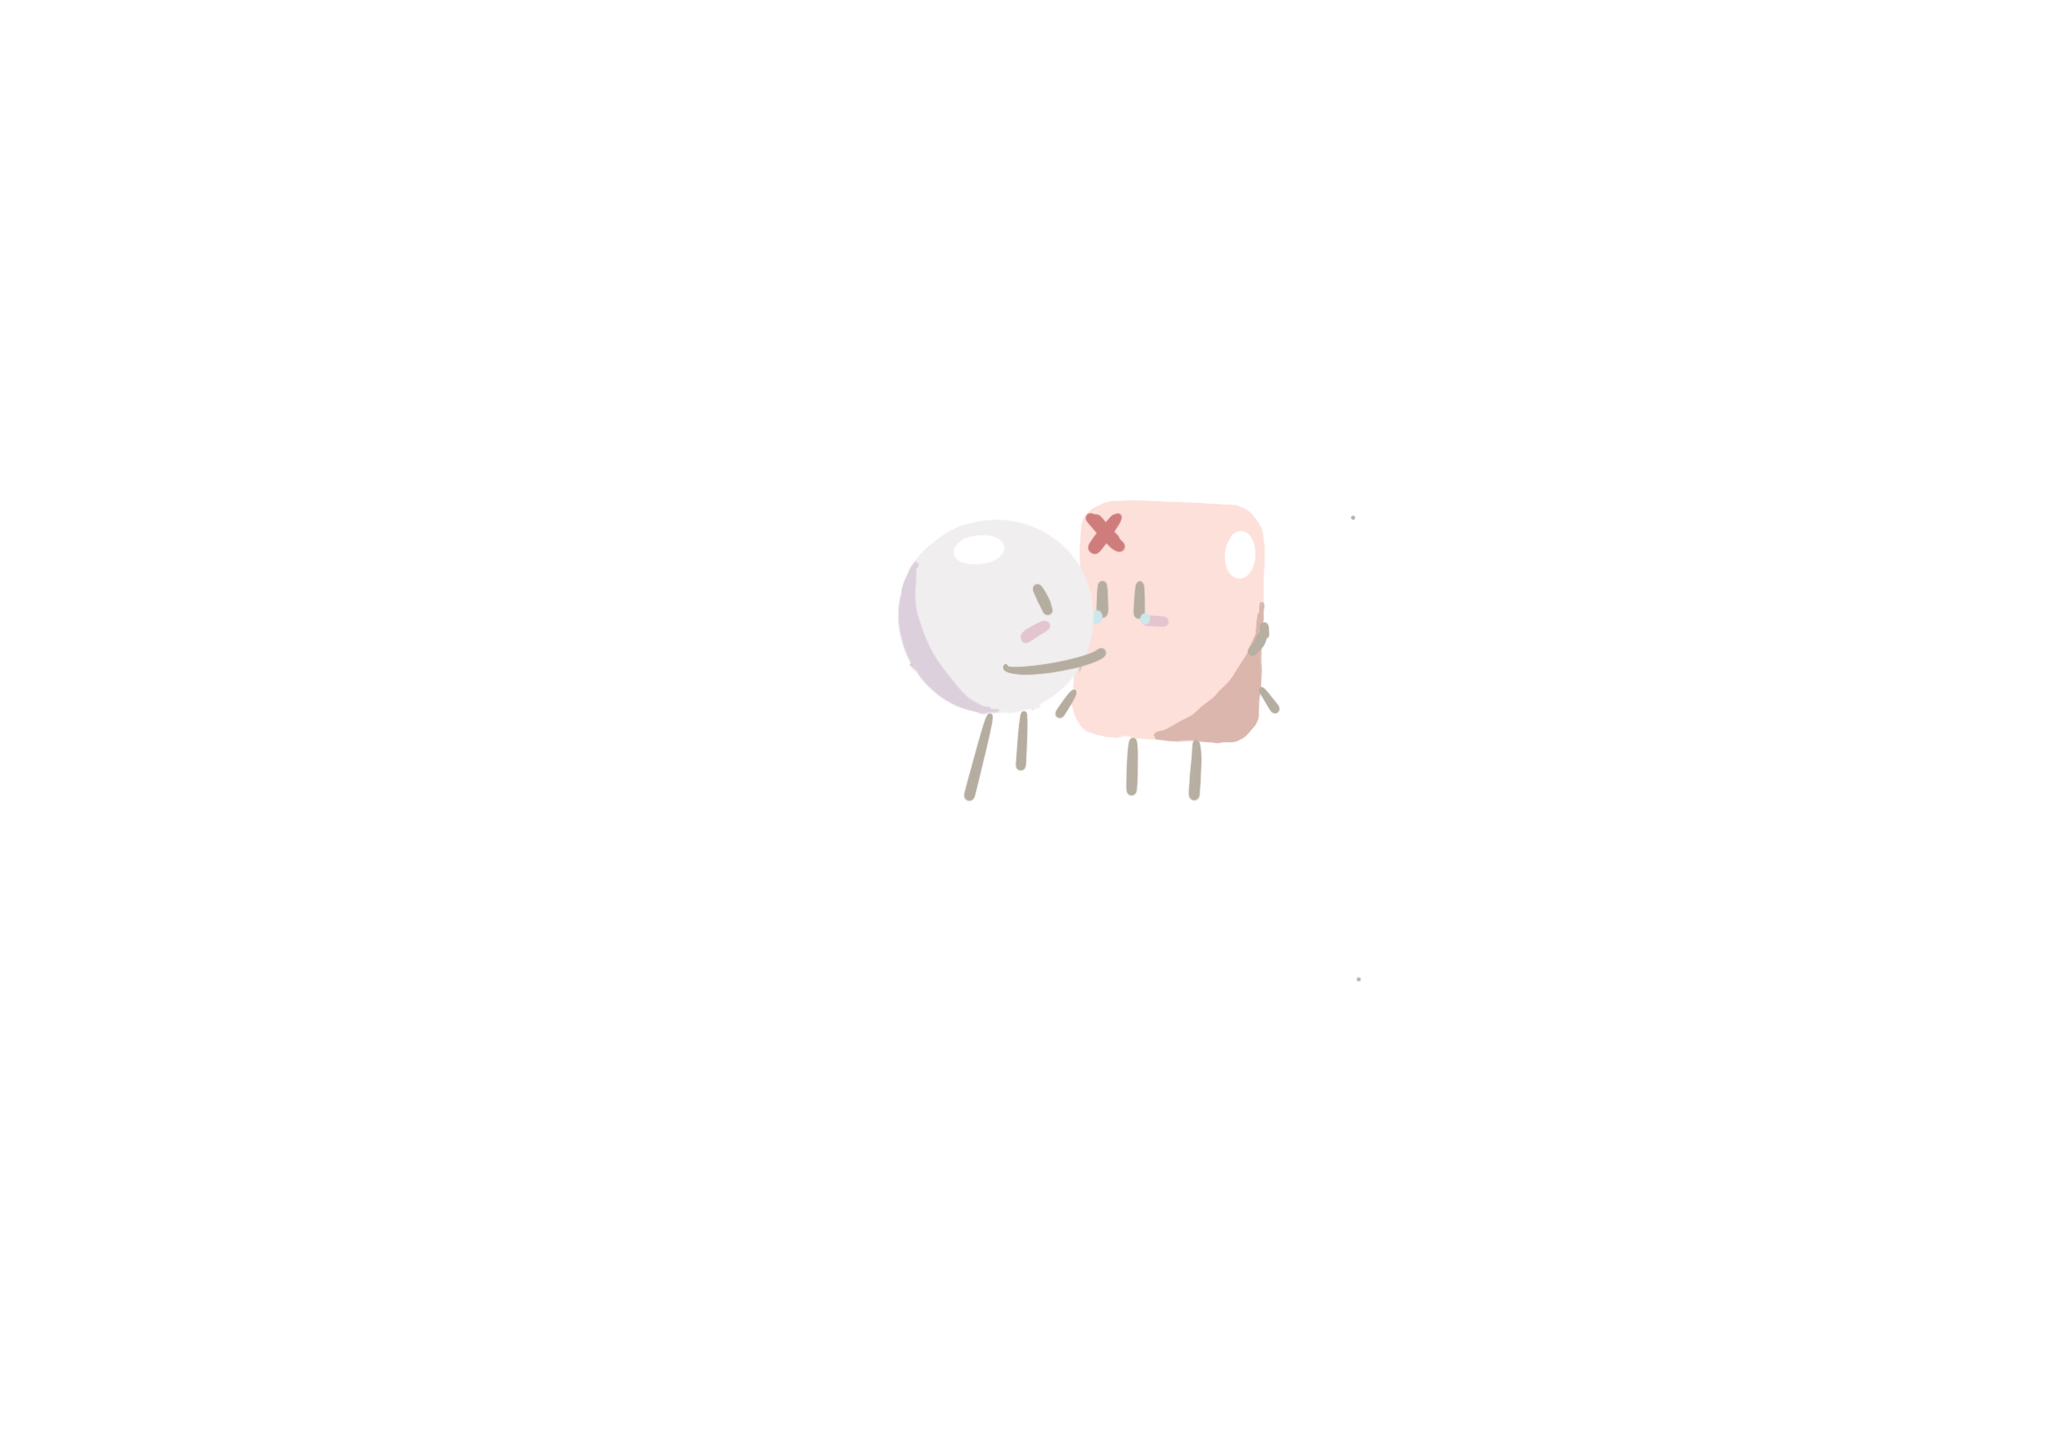
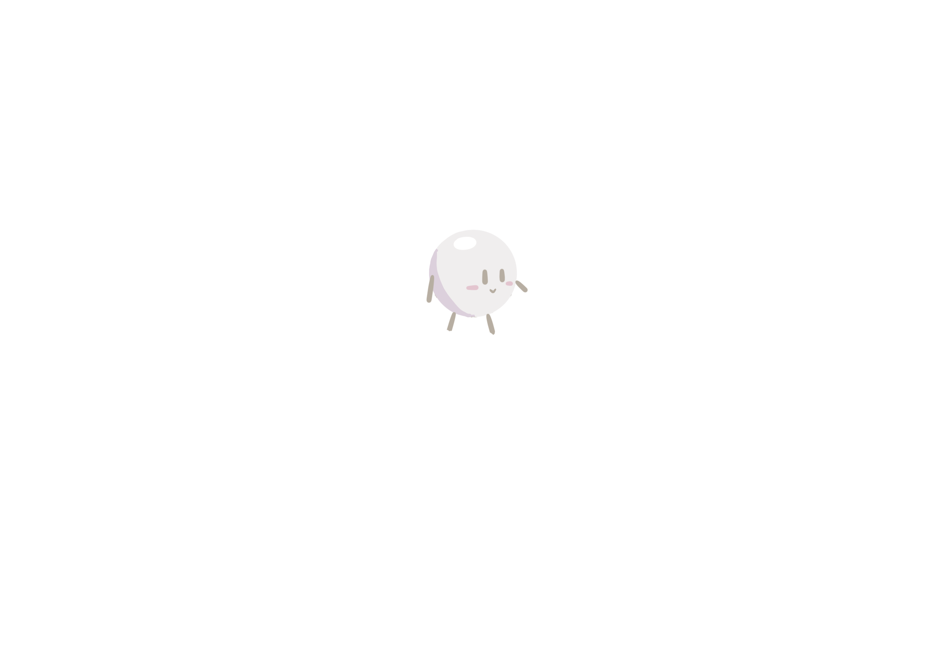

At the same time, we gently soothe the intestinal cells，
Fortunately, we modified the chassis bacteria and named it
to ensure that our clean-up efforts do not disturb our host's peace of mind.
"EnteroPlastivore"
*到这个页面，是一个白色小球向下滚，分别点亮三个白色发光框，同时，淡粉色波浪向下移，出现三幅画面，不同色块可以呈现一个QQ弹弹的效果。受PPT页面限制，可以之间间隔再大一点，其他动态效果可以再添加 ^^

Slide 18
Fortunately, we modified the chassis bacteria and named it
"EnteroPlastivore"
That's what we're all about.

Slide 19
见小红书
这交互好有童趣啊 小插画和木偶人一样，有趣 ﻿﻿ ... http://xhslink.com/o/58d4vUuisSs
复制后打开【小红书】查看笔记！
Fortunately, we modified the chassis bacteria and named it
"EnteroPlastivore"
That's what we're all about.

Slide 20
Eat all the plastic particles that shouldn't be there
Fortunately, we modified the chassis bacteria and named it
*页面变倒
"EnteroPlastivore"
That's what we're all about.

Slide 21
Eat all the plastic particles that shouldn't be there
Fortunately, we modified the chassis bacteria and named it
and give you a clean, healthy intestinal environment.
"EnteroPlastivore"
That's what we're all about.

Slide 22
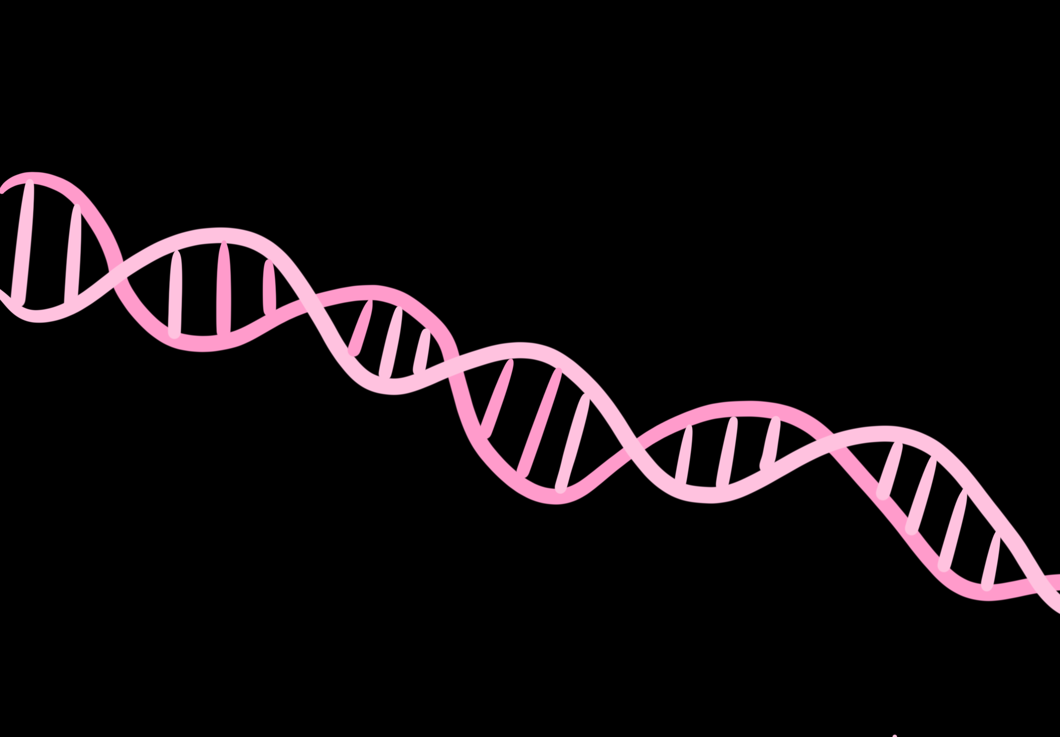
Eat all the plastic particles that shouldn't be there
Fortunately, we modified the chassis bacteria and named it
and give you a clean, healthy intestinal environment.
"EnteroPlastivore"
That's what we're all about.
*DNA从右边变出来
从蓝色的背景变成粉色的衔接，可以让DNA融化成液体然后填满页面

Slide 23
Project Profile
Fortunately, we modified the chassis bacteria and named it
*这三个画面放具体的质粒构建模块动画，参照北京大学珠海校区，注意颜色的协调
"EnteroPlastivore"

Slide 24
Project Profile
*这三个画面放具体的质粒构建模块，点击弹开具体介绍
，与湿租交流
Fortunately, we modified the chassis bacteria and named it
"EnteroPlastivore"

Slide 25
Fortunately, we modified the chassis bacteria and named it
Choose “EnteroPlastivore”
"EnteroPlastivore"
You are choosing to vote for a plastic-free future

Slide 26






*见小红书
值得参考！动画交互细节拉满的创意网站 这是一家位于... http://xhslink.com/o/3SGhRUM3FnC
复制后打开【小红书】查看笔记！类似效果，上面大色块掉下来等等
Fortunately, we modified the chassis bacteria and named it
"EnteroPlastivore"

Slide 27
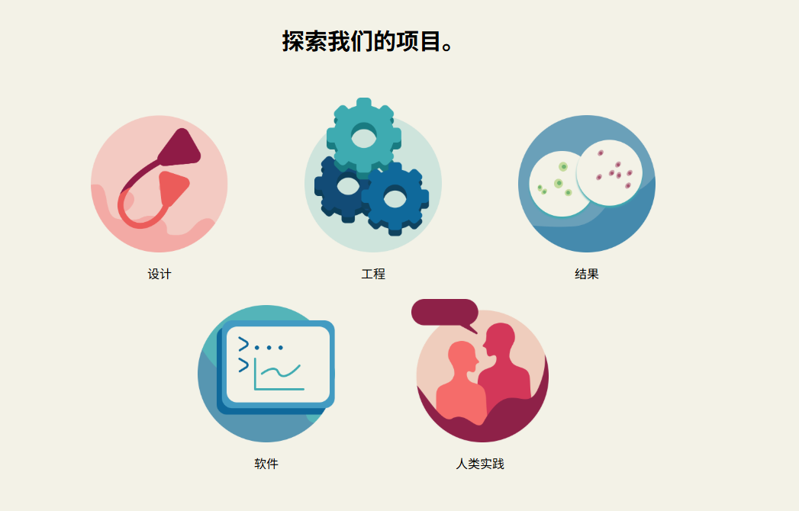
Explore our project.
*对应description engineering experiments HP product
等等 设计几个图标

Slide 28

*这里是底边栏
Contact
*对应跳转链接
EnteroPlastivore
iGEM NMU_China
© 2022 - Content on this site is licensed under a Creative Commons Attribution 4.0 International license.
The repository uXXXXXXXXsed to create this website is available at gitlab.igem.org/2022/epfl. XXXXXXXXXX

Slide 29

EnteroPlastivore
HOME
PROJECT
SAFETY
HUMAN PRACTICE
MODEL
TEAM
*等候界面做了个webp的话就放LOGO好了
Loading...

Slide 30
PXXXXXX
HOME
PROJECT
SAFETY
HUMAN PRACTICE
MODEL
TEAM

Slide 31
PXXXXXX
HOME
PROJECT
SAFETY
HUMAN PRACTICE
MODEL
TEAM
*这里用的平滑 本身是想做海浪汹涌的效果

Slide 32
EnteroPlastivore
HOME
PROJECT
SAFETY
HUMAN PRACTICE
MODEL
TEAM

Slide 33
EnteroPlastivore
HOME
PROJECT
SAFETY
HUMAN PRACTICE
MODEL
TEAM

Slide 34
EnteroPlastivore
HOME
PROJECT
SAFETY
HUMAN PRACTICE
MODEL
TEAM

